Slide 1

Direct marketing optimization
Modeling and results

Slide 2

Methodology overview
Solution development Strategy
Step 1: Predict Likelihood of buying a product for a client
Step 2: Predict total possible revenue that can be generated from a client (R)
Step 3: Find which product a client is most likely to buy and the probability of buying (P)
Step 4: Expected revenue from a client = P x R
Modelling Requirements
Binary Classifiers for each of financial products : Mutual Funds, Credit Card, Consumer Loans
Regression model to predict total possible revenue that can be generated from a client.
Modelling Workflow
Exploratory data analysis
Data Preparation
Imbalance
Missing data
Visualization
Outliers
Correlation
Remove correlated features
Remove outliers
Encode categorical features
Scale numerical features
Oversample
Select top 100 clients
Make predictions for clients with no sale information
Modelling
Select best model
Ensembling
Grid Search
Train-Test split
Select features
Determine candidate ML algorithms

Slide 3
Exploratory data analysis
Missing data
Only column with missing data was ‘Sex’, Removed 3 rows of missing data
Outliers
Columns containing credit / debit volume & transactions had few rows with values much larger than others. This was also true Balance information for various products. Identified outliers through percentile distribution of data. Determined threshold of 95 percentile or 99 percentile for each column, based on distribution analysis.
Correlation
Calculated correlation matrix for numerical columns using Pearson coefficient. Correlation information was used for removal of highly correlated columns. A threshold of 85% correlation was used to determine highly correlated columns.
Visualization
Visualized distribution of data via histograms, scatter plots
Imbalance
Class imbalance exists for all three classification problems, particularly for ‘Sale_MF’ and ‘Sale_CC’ predictions.
The total Revenue information across all products is also particularly skewed towards smaller values as evident from it’s histogram.
Following strategies were explored to reduce the impact of class imbalance, which will be discussed in details during modelling section:
Oversampling of data. Explored Random oversampling, and SMOTE. Did not consider undersampling as dataset is already small.
Providing increased weightage to minority class during model training process.
Stratified sampling to maintain class distribution across cross validations.
Feature Engineering
Correlation analysis shows moderate correlation amongst several numerical features such as total credit and total debit amount.
However, removal of either of these columns would mean loss of information as they represent important aspects of client’s financial habits.
Explored creation of ratios such as Monthly Savings percentage, percentage of spending done via Payment Order . However, for several clients this information became impossible to calculate as the columns such as Total Credit which formed denominator was 0.
Decided to not use Principle Component Analysis as it reduces explainability of model

Slide 4
data preparation
Scale Numerical Features
Normalized each column to mean 0 and standard deviation 1. This was done on training set after train-test split and before oversampling (if oversampling was used)
Encode categorical features
Used one-hot encoding for categorical column ‘Sex’ as it only contained 2 categories
Oversampling
Utilized 2 strategies:
Random oversampling : oversample with replacement
SMOTE
modeling
Modelling Goal
For Propensity prediction, our goal is to be able to identify as many of the clients which are actually going buy product (High recall). At the same time we have limited resources, hence we want to reduce false positives as it wastes resources and would result in loss of real customers (Good Precision)
Determine candidate ML algorithms
For Classification, explored XGBoost, Logistic Regression and Support Vector Machine.
For Regression, explored Ridge Regression, Regression using XGBoost and Polynomial Regression
Selected these algorithms based on :
Explainability : XGBoost, Logistic regression, Ridge / polynomial regression.
Effectiveness: XGBoost, SVM
Robustness against correlated features : XGBoost.
Computational considerations : Since dataset is small, training of models was not computationally expensive.
Visualization of scatter plots between target variable (total revenue) with predictive features showed non linear relationships. Hence explored polynomial regression.
Select features
Used forward feature selection for selection of features. This provided considerable improvement for Regression model. However, feature selection did not provide significant improvements for any of the classification models. Hence, only used feature selection for Regression model.

Slide 5
modeling
Train Test Split
Used Stratified sampling with 80-20 split between training data and test data.
For classification models Stratification was done on Sale_MF, Sale_CC, Sale_CL columns (whichever was the target variable).
For Regression, since Total Revenue (Revenue_MF+ Revenue_CC+ Revenue_CL) was skewed, binned the column using quantile values (0.5,0.75,0.85,0.95,1) and used these bins for stratification. Binning quantiles were determined through inspection of distribution.
Grid Search
For Classification model:
Selected set of parameters for each of:
Logistic regression : penalty, solver, C, number of iterations
XGBoost : number of boosting rounds, max depth of trees, learning rate, samples & features user per tree
Scaling of positive class was also done to counter the class imbalance.
SVM : X, gamma
Grid Search with Cross validation parameters:
Scoring : Used ‘roc_auc’ as we want to improve recall but also balance precision based on our modelling goal.
5-fold cross validation with Stratification.
Tried with and without oversampling.
For Regression model:
Selected set of parameters for each of:
Ridge regression : alpha
XGBoost : number of boosting rounds, max depth of trees, learning rate, samples & features user per tree
Polynomial : feature degrees, fit_intercept
Grid Search with Cross validation parameters:
Scoring : Used negative RMSE, as large errors in Revenue prediction are undesirable.
5-fold cross validation.
Ensembling
To explore if classification accuracy can be improved, explored ensembling :
Selected best model using grid search for Logistic Regression, XGBoost and SVM.
Ensembled them : For each data item, predicted probabilities using each of the models, and selected the maximum out of the three to make prediction.
Ensemble method had adverse performance than individual models as in general it was improving the False negatives but increasing False positives significantly. Hence did not proceed with it.

Slide 6
modeling
Select best model
For Classification :
For each product, build models using combination of : ML Algorithm, Oversampling enabled or not, Model Class weight scaling done or not, Feature Selection enabled or not.
Final model was selected based on :
Result on test dataset : Precision and Recall values.
Cross validation results : Average AUC and variance of AUC across CV runs.
XGBoost gave best models for all 3 financial products (MF, CL,CC)
For Regression :
Ridge Regression gave the best results.Best estimator was selected based on grid search.
Performance of other ML algorithms was very bad hence not considered.
Generating results
Make predictions for clients with no sale information
Select data points for which no sale information is available. These data points are selected from data cleaned during EDA, so it does not contain rows removed during outlier removal, missing information removal.
Remove columns from data which are not required by model.
Encode categorical variable.
Scale numerical columns using scaler fitted on training data for the model. Scaler was stored as pickle file during model training.
Make following predictions:
Sale_MF,Sale_CC, Sale_CL : Binary prediction (0/1) if the client will buy the product. Probability prediction – probability of client buying the product.
Total Revenue : For each client, possible total revenue that can be generated.
Select top 100 clients
For each client, identify which product has the maximum predicted probability of being bought, and the associated probability. Expected revenue the client can generate = Predicted total revenue * predicted probability.
Identify top 100 clients with most expected revenue generation.

Slide 7
Result analysis
Which clients higher propensity to buy these products? : We can determine the client characteristics by exploring the feature importance returned by each model and comparing the target variable variation with the feature value using box plot.
Mutual Funds
Client characteristic | Possible rationale
Tenure | Clients with slightly longer tenure are more likely to buy MF as evident from box plot
ActBal_CA | Clients with less than ~1500 in current account are more likely to buy
VolumeDebCashless_Card | Clients with more spending on cashless card transactions are more likely to buy
VolumeCred | Clients with larger credit volumes are more likely to buy.
Age | Clients in the age group ~ (30-55)
Summary
Clients in age group ~ 30-55 and who have larger credit inflow, and tend to keep less money in current account are more likely to buy mutual funds. This seems reasonable as such clients will likely have more savings. Such clients also tend to favour cashless card transactions for spending
Client characteristic | Possible rationale
Tenure | Tenure more than 50+ months. More loyal clients more likely to buy
Age | Age from ~35+ to 58, are more likely to buy
VolumeCred | Less credit intake are more likely to buy
ActBal_CA | Clients lower balance values
TransactionsDeb | Less debit transactions
Summary
The results show that clients who have been with the bank for some time but have low credit in their account, and also do less transactions are more likely to apply for credit cards. These may be customers who do not use the bank for their primary financial needs but may be attracted with the credit card features provided by the bank.
Credit Cards
Consumer Loans
Client characteristic | Possible rationale
Tenure | More loyal clients more likely to buy
Age | Age from early 20s to mid 40s
VolumeCred | Less credit intake are more likely to buy
ActBal_CA | Clients lower balance values
VolumeDeb | Higher debit volumes
Summary
Clients from young adults to mid-40s , who have been with the bank for some time, and who have less money coming in but larger spending are more likely to buy consumer loans. This seems reasonable as such clients naturally have a need for loans. Age group also indicates young adults who may need for education/ marriage etc and 30-40s who have increased consumer needs.

Slide 8
Result analysis
Which clients are to be targeted with which offer?
The file ‘Targeted Client List.xlsx’ under ‘./Documents’ indicates which clients should be targeted with which offer. This file contains the top 100 clients which should be targeted, identified by ‘Client’ column, and split across sheets based on product type . The column ‘Expected Revenue’ indicated which product they should be offered in the marketing strategy : CC (Credit Card), MF(Mutual Fund), CL (Consumer Load).
What would be the expected revenue based on your strategy?
Expected revenue will be the sum of ‘Expected Revenue’ from the file ‘Targeted Client List.xlsx’ under ‘./Documents’ . This column indicates expected revenue for each client. Expected revenue based on our model : 1119.09 EUR

Slide 9
appendix

Slide 10
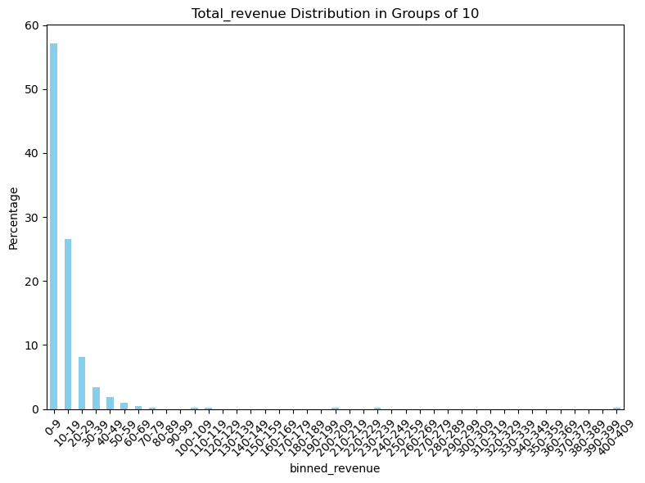
Distribution of Total Revenue across all product types

Slide 11
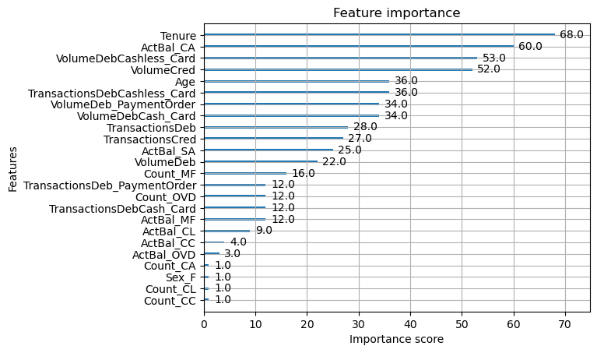
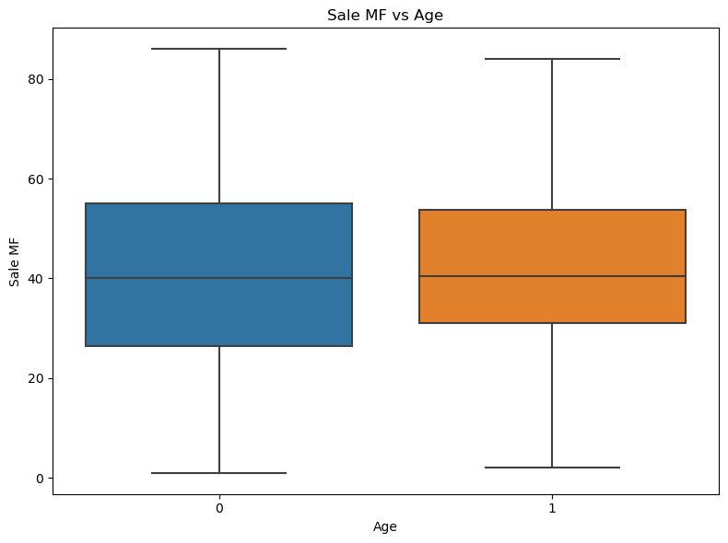
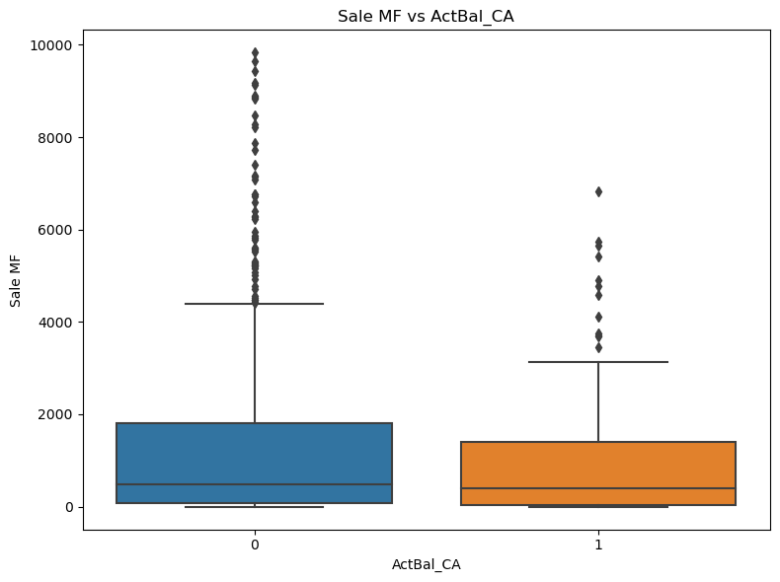
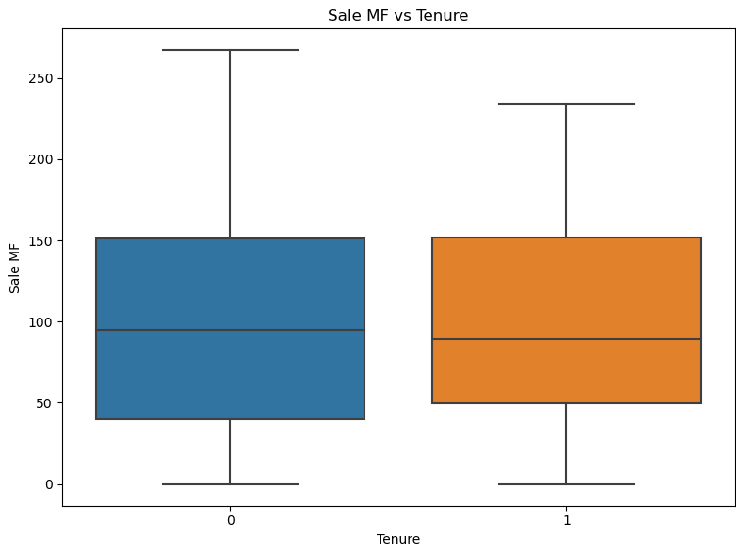
Sale_MF model feature importance

Slide 12
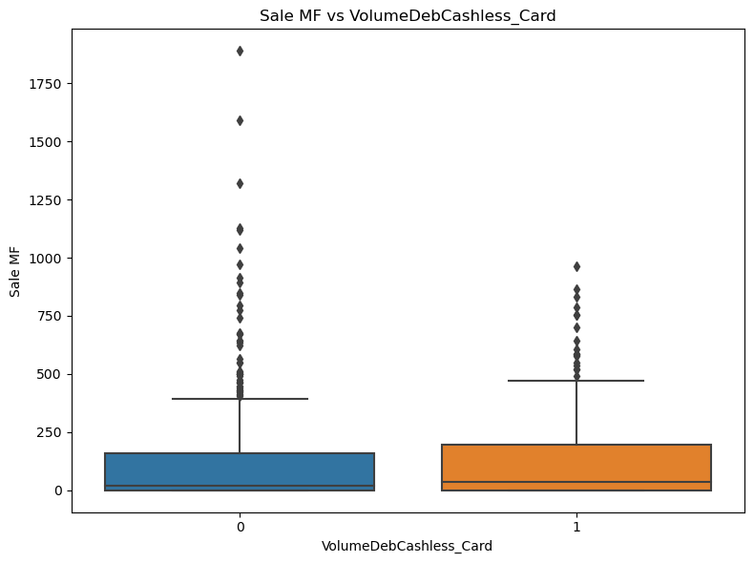
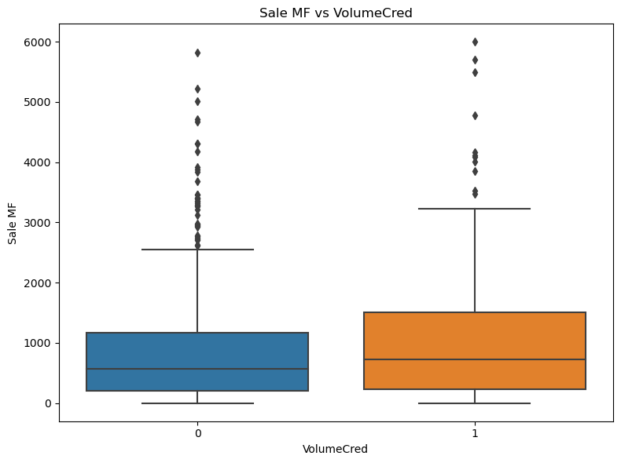
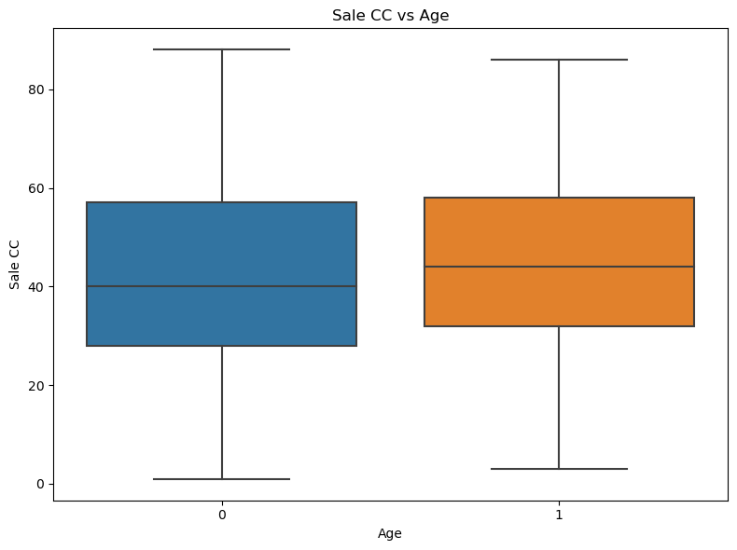


Slide 13
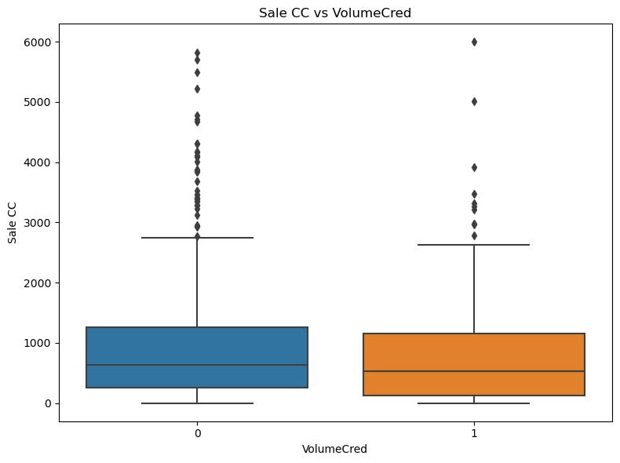
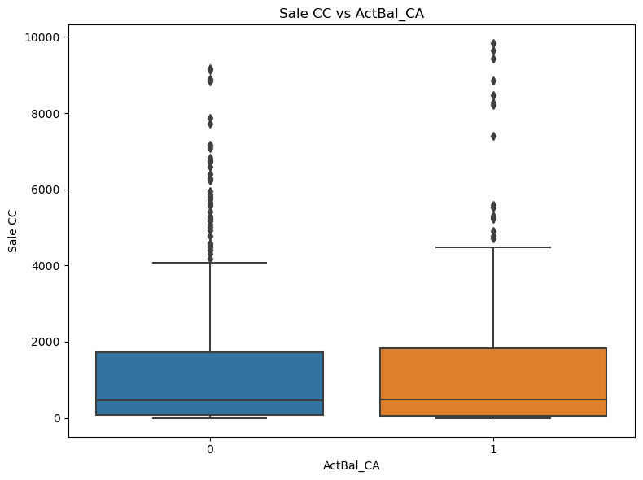
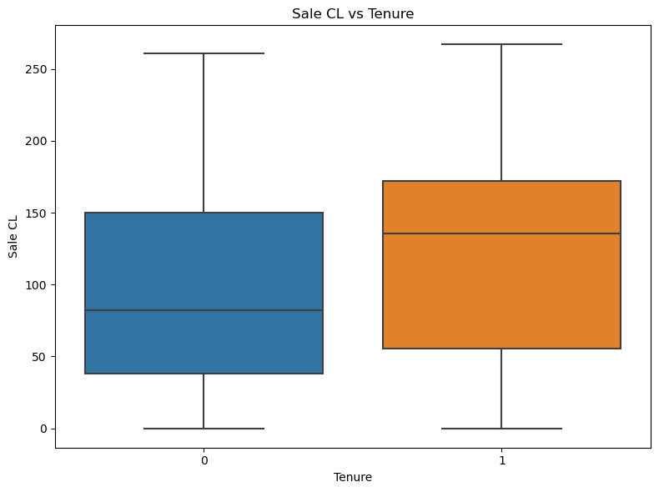
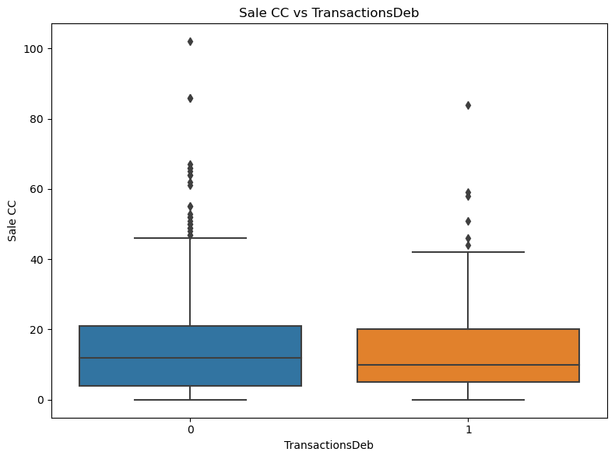

Slide 14
